Slide 1
Programming Fundamental
Week 05
Sobia Iftikhar
Sobia.Iftikhar@nu.edu.pk

Slide 2
Class 13

Slide 3
Problem
#include<stdio.h>
main() {
int cp,sp,rslt;
printf("Please enter the cost price of the item: \n");
scanf("%d",&cp);
printf("Please enter the selling price of the item: \n");
scanf("%d",&sp);
if(cp>sp) {
rslt=cp-sp;
printf("\nSeller has incurred LOSS of %d rupees.\n",rslt);
}
if(cp<sp)
{
rslt=sp-cp;
printf("\nSeller has made PROFIT of %d rupees.\n",rslt);
}
return 0;
}
If cost price and selling price of an item is input through the keyboard, write a program to determine whether the seller has made profit or incurred loss. Also determine how much profit he made or loss he incurred.

Slide 4
Nested if
A nested if in C is an if statement that is the target of another if statement. Nested if statements mean an if statement inside another if statement. Yes, both C and C++ allow us to nested if statements within if statements.
if (condition1)
{
// Executes when condition1 is true
if (condition2)
{
// Executes when condition2 is true
}
}

Slide 5
Nested if-else
main( )
{
int i ;
printf ( "Enter either 1 or 2 " ) ;
scanf ( "%d", &i ) ;
if ( i == 1 )
printf ( "You would go to heaven !" ) ;
else
{
if ( i == 2 )
printf ( "Hell was created with you in mind" ) ;
else
printf ( "How about mother earth !" ) ;
}
}

Slide 6
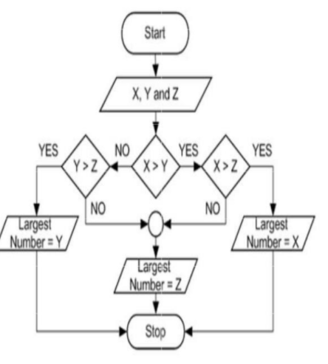
example
intx,y,z;
printf("Enter value of X");
scanf("%d",&x);
printf("Enter value of Y");
scanf("%d",&y);
printf("Enter value of Z");
scanf("%d",&z);
if(x>y){
if(x>z){
printf("The largest value is of x = %d",x);
}
else{
printf("The largest value is of z =%d", z);
}
}
else{
if(y>z){
printf("The largest value is of y= %d",y);
}
else{
printf("The largest value is of z= %d",z);
}
}

Slide 7
Problem
A company insures its drivers in the following cases:
− If the driver is married.
− If the driver is unmarried, male & above 30 years of age.
− If the driver is unmarried, female & above 25 years of age

Slide 8
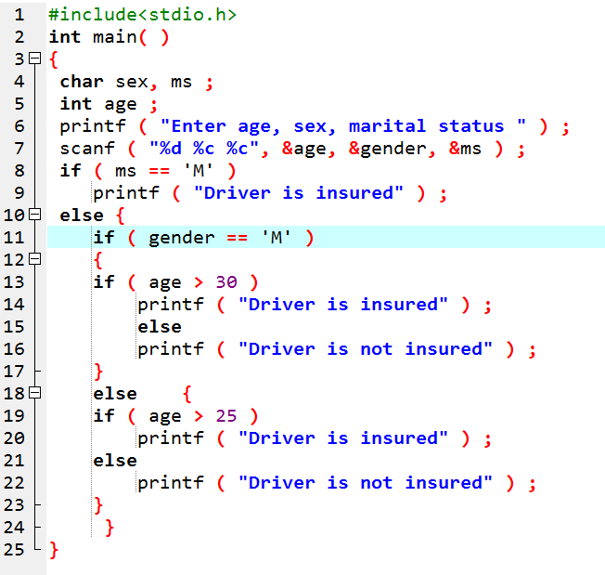
Solution

Slide 9
Switch with IF
Switch(){
case 1:
Statement
break;
case 2:
statement
if () {
}
break;
default:
statement}

Slide 10
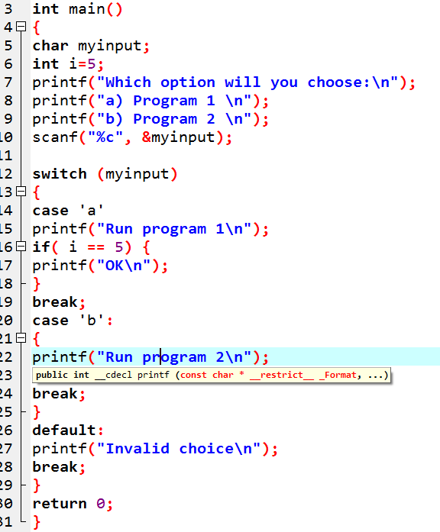
Switch with If

Slide 11
Switch Case Structure [Cont.]
The expression can be integer expression or a character expression.
Value-1, 2, n are case labels which are used to identify each case individually.
Case labels always end with a colon ( : ). Each of these cases is associated with a block.
A block is nothing but multiple statements which are grouped for a particular case.
Whenever the switch is executed, the value of test-expression is compared with all the cases which we have defined inside the switch.

Slide 12
Switch Case Structure [Cont.]
The break keyword in each case indicates the end of a particular case. If we do not put the break in each case then even though the specific case is executed, the switch will continue to execute all the cases until the end is reached. This should not happen; hence we always have to put break keyword in each case. Break will terminate the case once it is executed and the control will fall out of the switch.
The default case is an optional one. Whenever the value of test-expression is not matched with any of the cases inside the switch, then the default will be executed.
Otherwise, it is not necessary to write default in the switch.

Slide 13
Nested Switch
Switch(){
case 1:
Statement
break;
case 2:
switch(){
case 1:
Statement
break;
case 2:
Statement
break;
default:
statement
break;
}
break;
default:
statement
}
Nested Switch Statements occurs when a switch statement is defined inside another switch statement.
In C, we can have an inner switch embedded in an outer switch. Also, the case constants of the inner and outer switch may have common values and without any conflicts..

Slide 14
Nested Switch
switch (a)
{
printf("This a is part of outer switch" );
case 1: // code to be executed if a = 1;
break;
case 2:
switch(b)
{
case 1:
// code to be executed if b = 1;
printf("This b is part of inner switch" );
break;
case 2:
// code to be executed if b = 2;
printf("This b is part of inner switch" );
break;
}
break;
default:
// code to be executed if
// a doesn't match any cases
}

Slide 15
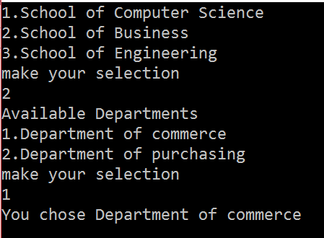
Example
switch (a)
{
case 1:
//code to be executed
//if school of computer science is chosen;
break;
case 2:
//code to be executed
//if school of business is chosen;
printf("Available Departments\n"
printf("1.Department of commerce\n");
printf("2.Department of purchasing\n");
printf("Make your selection.\n");
scanf("%d",&b);
//inner switch to display the departments
//under the school of commerce
switch(b)
{
case 1:
// code to be executed if b = 1;
printf("You chose Department of commerce\n" );
break;
case 2:
// code to be executed if b = 2;
printf("You chose Department of purchasing" );
break;
}
break;
}
}
int main()
{
int a,b;
printf("1.School of Computer Science\n");
printf("2.School of Business\n");
printf("3.School of Engineering\n");
printf("make your selection\n");
scanf("%d",&a);

Slide 16
Class 14

Slide 17
Semicolon after If
If();
Printf(“”);

Slide 18
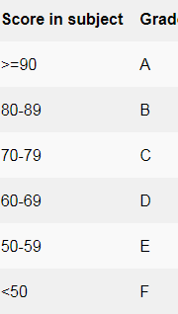
Example
int score;
printf("Enter score( 0-100 ): ");
scanf("%d", &score);
switch( score / 10 )
{
case 10:
case 9:
printf("Grade: A");
break;
case 8:
printf("Grade: B");
break;
case 7:
printf("Grade: C");
break;
case 6:
printf("Grade: D");
break;
case 5:
printf("Grade: E");
break;
default:
printf("Grade: F");
break;
}

Slide 19
Example
#include <stdio.h>
int main() {
int ID = 500;
int password = 000;
printf("Please Enter Your ID:\n ");
scanf("%d", & ID);
switch (ID) {
case 500:
printf("Enter your password:\n ");
scanf("%d", & password);
switch (password) {
case 000:
printf("Welcome Dear Programmer\n");
break;
default:
printf("incorrect password");
break;
}
break;
default:
printf("incorrect ID");
break;
}
}

Slide 20


Switch using range
You all are familiar with switch case in C/C++, but did you know you can use range of numbers instead of a single number or character in case statement.
// Correct - case 1 ... 5:
// Wrong - case 1...5:

Slide 21
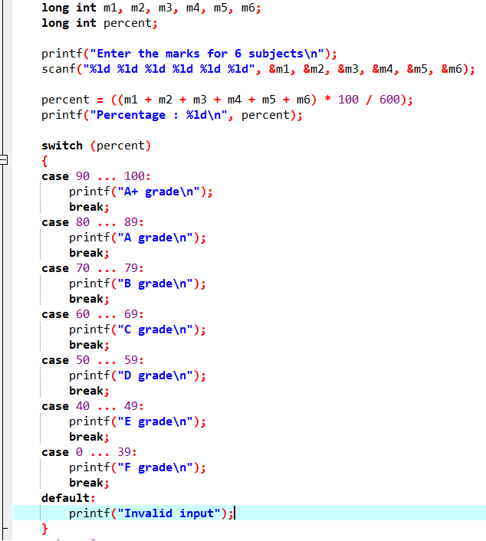
Switch Using Range- example

Slide 22
Nested Switch
Why do we need a Switch case?
There is one potential problem with the if-else statement which is the complexity of the program increases whenever the number of alternative path increases. If you use multiple if-else constructs in the program, a program might become difficult to read and comprehend.
Sometimes it may even confuse the developer who himself wrote the program.
The solution to this problem is the switch statement.

Slide 23
Possible types of the <expression> in switch
The <expression> in a switch statement can have any of these types:
byte, short, char, and int
wrapper classes Byte, Short, Character, and Integer
String
any enum type

Slide 24
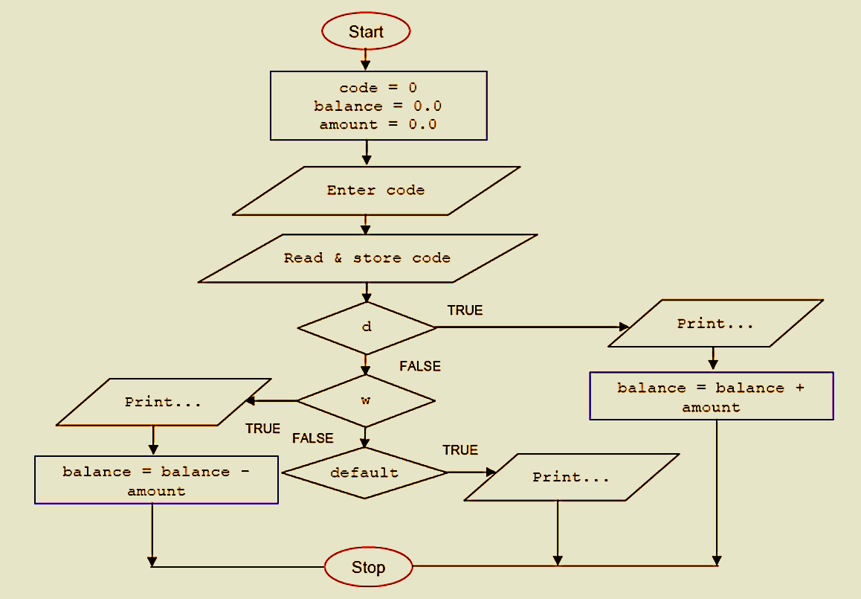
int main(){
char code = 'd';
float balance = 0.0, amount = 0.0;
printf("Enter your transaction code, d - deposit, w -
withdrawal: \n");
scanf(" %c", &code);
// switch-case-break statement...
switch(code)
{
case 'd':
{
printf("Your deposit...\n");
balance = balance + amount;
break;
}
case 'w':
{
printf("Your withdrawal...\n");
balance = balance - amount;
break;
}
default:
printf("%c code not allowed. Try again!\n", code);
} return 0;}

Slide 25
TASK:
Write a C program to print number of days in a month when user inputs the number of month using switch condition.

Slide 26
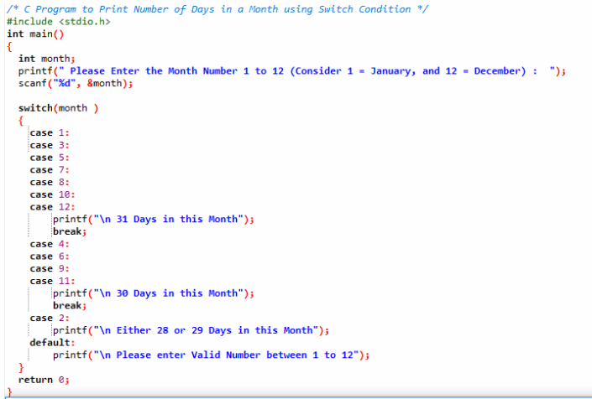

Slide 27
Task
Ayesha is interested in knowing the names of different countries. She wants a list of countries by just giving an starting and ending letter.

Slide 28
Class 15

Slide 29
Conditional Operators
Write a program to find maximum between three numbers using conditional operator
void main()
{
int a, b, c, big ;
printf("Enter three numbers : ") ;
scanf("%d %d %d", &a, &b, &c) ;
big = a > b ? (a > c ? a : c) : (b > c ? b : c) ;
printf("\nThe biggest number is : %d", big) ;
}

Slide 30
The Conditional Operators
The conditional operators ? and : are sometimes called ternary operators since they take three arguments. In fact, they form a kind of foreshortened if-then-else.
Their general form is,
expression 1 ? expression 2 : expression 3
What this expression says is: “if expression 1 is true (that is, if its
value is non-zero), then the value returned will be expression 2,
otherwise the value returned will be expression 3

Slide 31
The Conditional Operators
int x, y ;
scanf ( "%d", &x ) ;
y = ( x > 5 ? 3 : 4 ) ;
This statement will store 3 in y if x is greater than 5, otherwise it will store 4 in y. The equivalent if statement will be,
if ( x > 5 )
y = 3 ;
else
y = 4 ;

Slide 32
The Conditional Operators
char a ;
int y ;
scanf ( "%c", &a ) ;
y = ( a >= 65 && a <= 90 ? 1 : 0 ) ;
Here 1 would be assigned to y if a >=65 && a <=90 evaluates to true, otherwise 0 would be assigned.

Slide 33


It’s not necessary that the conditional operators should be used only in arithmetic statements.

Slide 34
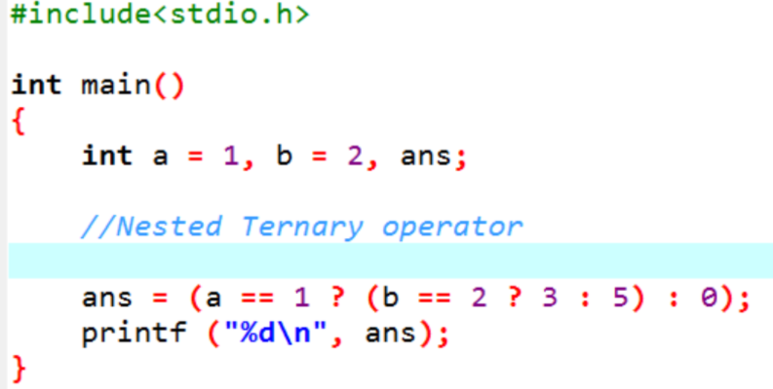

Slide 35
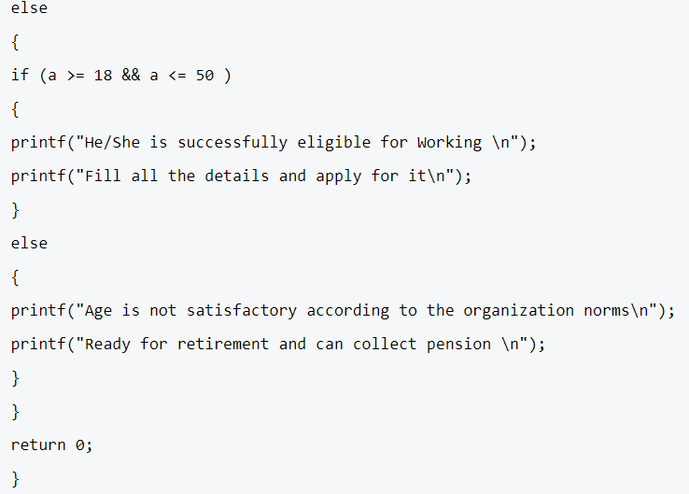
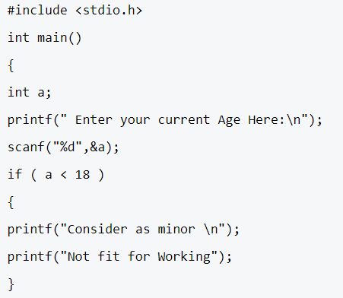
Task
Program for analysis of people of certain age groups who are eligible for getting a suitable job if their condition and norms get satisfied using nested if else statement.

Slide 36

Predict
#include<stdio.h> void numberPrint() { int a = 1; label: printf("%d \n", a); a=a+1; if (a <= 5) goto label; } int main() { numberPrint(); return 0; }

Slide 37
Task
Check whether the triangle is equilateral, scalene, or isosceles
Before writing the program, we should know the properties of isosceles, equilateral, and scalene triangles.
Isosceles triangle: In geometry, an isosceles triangle is a triangle that has two sides of equal length.
Equilateral triangle: In geometry, an equilateral triangle is a triangle in which all three sides are equal.
Scalene triangle: A scalene triangle is a triangle that has three unequal sides.

Slide 38
#include <stdio.h>
int main(void)
{
int triSide1, triSide2, triSide3;
/* Get sides of a triangle from the user */
printf("\n Enter first side of triangle: = ");
scanf("%d", &triSide1);
printf("\n Enter second side of triangle: = ");
scanf("%d",&triSide2);
printf("\n Enter third side of triangle: = ");
scanf("%d",&triSide3);
if((triSide1==triSide2) && (triSide2==triSide3))
{
/* If all sides are equal, then Equilateral triangle*/
printf("\n Equilateral triangle.\n\n");
}
else if((triSide1==triSide2) || (triSide1==triSide3) || (triSide2==triSide3))
{
/* If two sides are equal, then Isosceles triangle*/
printf("\n Isosceles triangle.\n\n");
}
else
{
/* If none sides are equal, then Scalene triangle*/
printf("\n Scalene triangle.\n\n");
}
return 0;

Slide 39
Logical vs bitwise (&& or &) (|| or |)
A Bitwise And operator is represented as ‘&’ and a logical operator is represented as ‘&&’. The following are some basic differences between the two operators.
a) The logical and operator ‘&&’ expects its operands to be boolean expressions (either 1 or 0) and returns a boolean value. the bitwise and operator ‘&’ work on Integral (short, int, unsigned, char, bool, unsigned char, long) values and return Integral value.
#include<stdio.h>
int main()
{
int x = 3; //...0011
int y = 7; //...0111
// A typical use of '&&'
if (y > 1 && y > x)
printf("y is greater than 1 AND x\n");
// A typical use of '&'
int z = x & y; // 0011
printf ("z = %d", z);
return 0;
}
Y is greater 1
3

Slide 40
Logical &&
Assume variable A holds 1 and variable B holds 0, then −
Operator | Description | Example
&& | Called Logical AND operator. If both the operands are non-zero, then the condition becomes true. | (A && B) is false.
|| | Called Logical OR Operator. If any of the two operands is non-zero, then the condition becomes true. | (A || B) is true.
! | Called Logical NOT Operator. It is used to reverse the logical state of its operand. If a condition is true, then Logical NOT operator will make it false. | !!(A && B) is true.

Slide 41
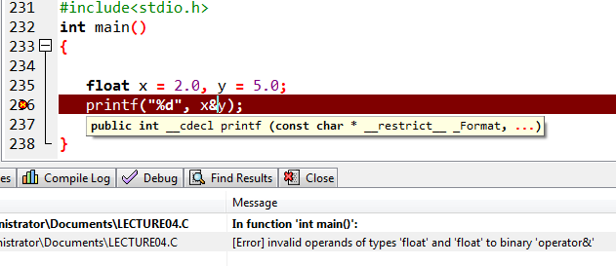
Logical vs bitwise (&& or &) (|| or |)
b) If an integral value is used as an operand for ‘&&’ which is supposed to work on boolean values, the following rule is used in C. Zero is considered as false and non-zero is considered as true.
#include<stdio.h>
// Example that uses non-boolean expression as
// operand for '&&'
int main()
{
int x = 2, y = 5;
printf("%d", x&&y);
return 0;}
#include<stdio.h>
// Example that uses non-integral expression as
// operator for '&'
int main()
{
float x = 2.0, y = 5.0;
printf("%d", x&y);
return 0;
}
1

Slide 42
Logical vs bitwise (&& or &) (|| or |)
0 Geeks in & 0
c) The ‘&&’ operator doesn’t evaluate the second operand if the first operand becomes false. Similarly ‘||’ doesn’t evaluate the second operand when first operand becomes true. The bitwise ‘&’ and ‘|’ operators always evaluate their operands. .
#include<stdio.h>
int main()
{
int x = 0;
// hello in &&' is NOT
// printed because x is 0
printf("%d\n", (x && printf("Geeks in && ")));
// ‘hello in &' is printed
printf("%d\n", (x & printf("Geeks in & ")));
return 0;
}
0
Hello in & 0

Slide 43
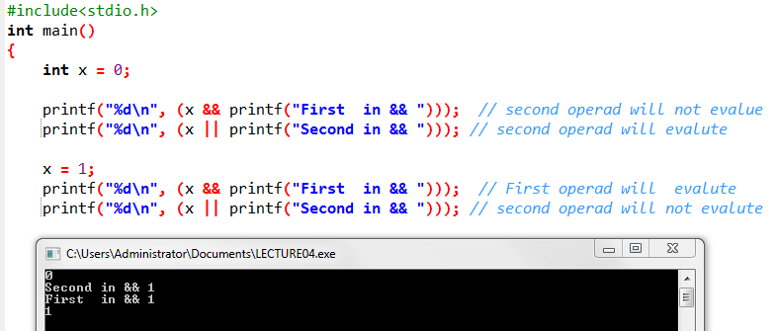
Example

Slide 44
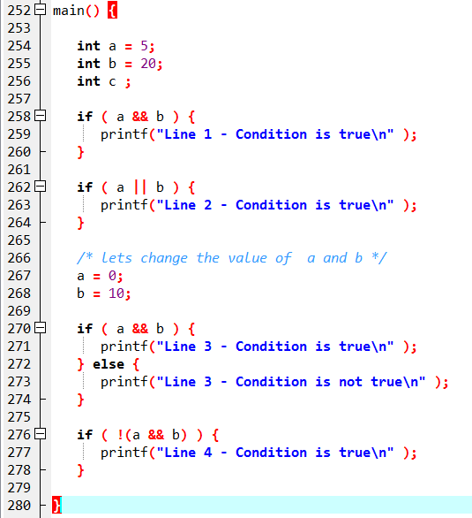
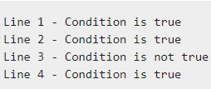
Example

Slide 45
Example
#include <iostream>
using namespace std;
int main()
{
int a = 10, b = 4;
bool res = ((a == b) && printf ( “hello PF");
return 0;
}
No Output

Slide 47
Thankyou

